Slide 1
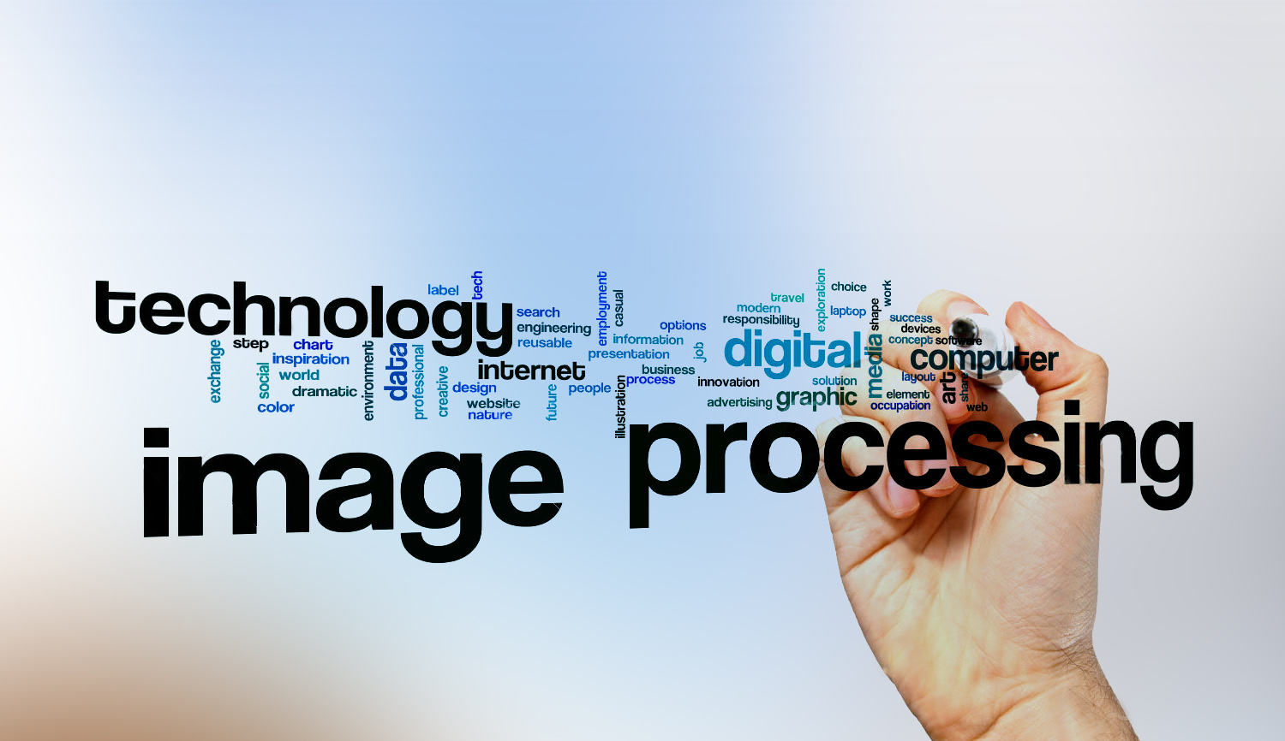

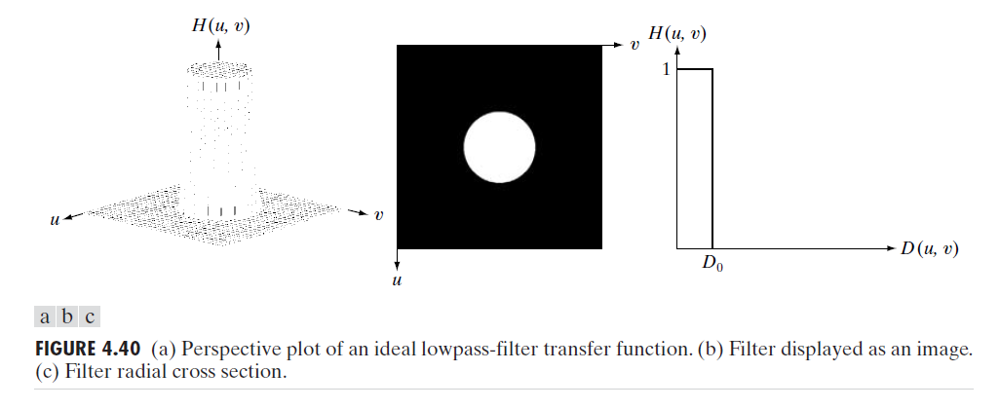
Digital Image Processing
25- ideal low pass filter
smoothing methods

Slide 2
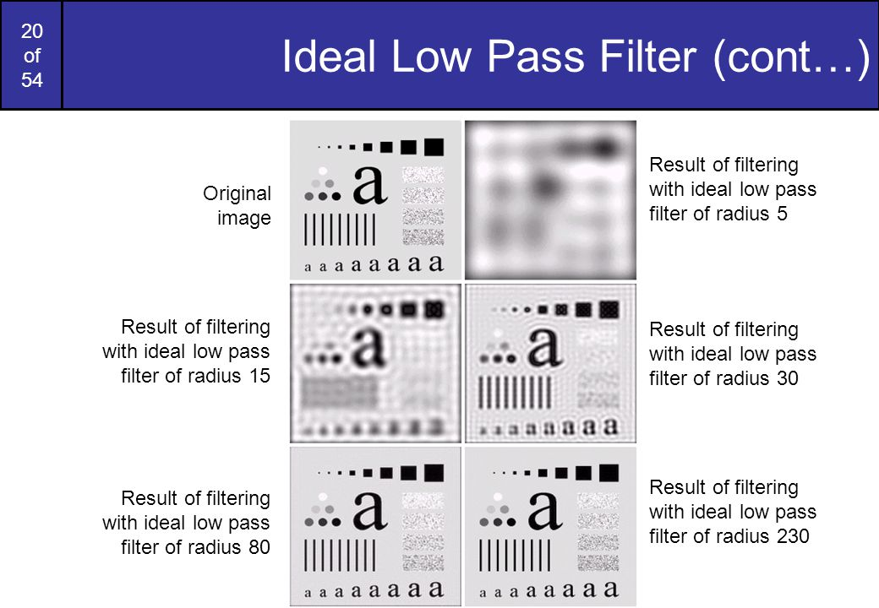
Digital Image Processing
25- ideal low pass filter

